Slide 1
Teacher
Career Day Presentation

Slide 2
Education
Four Year Degree
1st two years-basic courses
You could attend Community College
Decide on a major (area of focus) by junior year.
You will have to take the Praxis exam to earn your certification
Common Teacher Education Courses Include:
Courses in area of study
Diversity
Best practices
Technology
Classroom Management
Student Teaching

Slide 3
Teacher Salaries Comparable to Other Careers
IT Specialist- $60-90,000/year
Car mechanic $40-60,000
Police officer $45-55,000
Nurse- Varies depending upon hospital
Medical Technologist $60-70,000
Accountant $50-70,000
 | B.A. | M.Ed.
1-4 years | $40,000 | $44,000
5-9 years | $42,000 | $46,000
30+ | $58,500 | $65,000

Slide 4
What are you responsibilities as a teacher?
Teaching large groups of students
Tutoring individuals and small groups
Planning and implementing effective lessons
Analyze data to guide the lessons
Grading and providing feedback
Helping students develop character and a strong work ethic
Helping students gain and maintain strong self-esteem
Manage a classroom full of students, providing for the individual needs of each

Slide 5
What are you responsibilities as a teacher?
Communicating with parents, students, colleagues and administration
Acting as a counsellor for students who seek help
Identifying struggles of those students who do not seek help
Being an entertainer
Mediating conflicts
Creating fun and interactive ways to present information in a variety of ways
Challenging others and yourself
Learning something new everyday

Slide 6
After the Bell
Coaching
basketball
cheer
football
volleyball
Clubs
step team
student council
yearbook
Washington DC
plays
museums
Field Trips

Slide 7
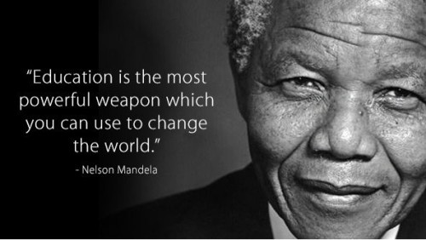

Slide 8
So is teaching a possibility for you?
Are you creative?
Do you enjoy working with others?
Are you able to multitask?
Can you think on your feet?
Are you able to mediate conflicts?
Are you task/goal oriented?
Do you enjoy feeling like you have made a difference?

Slide 9
So is teaching a possibility for you?
Do you have a passion for reading, writing, math, science, history, music, art, technology, etc. that you love to share with others?
Do you enjoy having the summers off?
Are you patient?
Are you able to show and explain things to others in ways they can understand?
Do you enjoy helping others?
Do you like creating awesome presentations like this PowerPoint?
Do you love asking questions?

