Slide 1
Frankenstein: A Modern Prometheus
By Mary Shelley
Notes:
Prometheus – Greek Titan who gave humans fire (thereby making them “human” rather than “animal”); also supposedly helped to create mankind. After the war between the Greek Gods and the Titans, Prometheus was chained to a rock to have his innards eaten by an eagle every day for eternity.

Slide 2
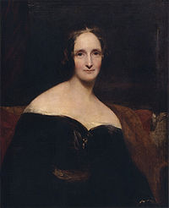
Author – Mary Shelley
Lived from August 20, 1797 to February 1, 1851 (53)
Somers Town, London
Married to Percy Shelley (“Ozymandias”)
Was actually famous as an author while she was alive
Dealt with depression throughout much of her early life, due to her first child’s death
Part of a group of writers, who sometimes went by either the names of “The Lord Byron Club” or even “The Geneva Convention.”
Notes:
“Ozymandias”, written by her husband, has been referenced in a lot of different modern media, from Lost to Breaking Bad (the video clip), to even other works of literature. It also shares some meaning with Frankenstein (they were published in the same year), as while Victor initially seems to think himself some great scientist who will always be remembered, in the end he has nothing to show for his work.
Her first child was born about two months premature, leading to its death; as a result, Shelley suffered from depression throughout much of her life
Ironically, her husband may have actually killed himself because she was more popular while she was alive than he was; he drowned at sea, though some others speculate it may have been accidental.

Slide 3
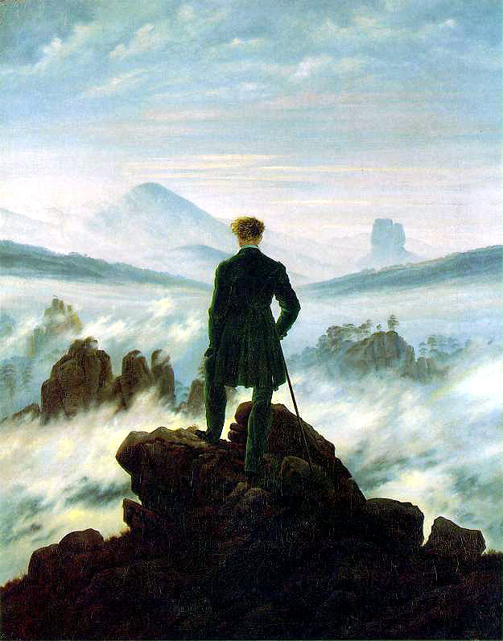
Frankenstein
Published anonymously in 1818 (later Mary Shelley’s name is put on the second edition in 1823)
An early example of a Gothic novel, though considered primarily a part of the Romantic movement.
Follows the plight of Victor Frankenstein
Considered the first “true” science-fiction novel
Notes:
- Considered the first “true” science-fiction novel because it had a noticeable lack of magical or fantastical elements; the monster was created through some unknown science (probably electricity) rather than magic.

Slide 4
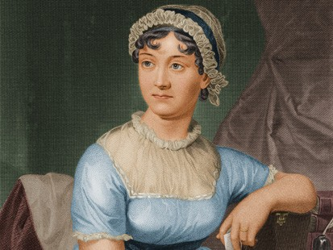
Romantic Literature (19th century)
Literary and artistic movement primarily focused around emotions, originality, and beauty.
In literature, much emphasis was placed on isolation
Authors such as Samuel Coleridge (“The Rime of the Ancient Mariner”), John Polidori (“The Vampyre”), Jane Austen (“Pride and Prejudice”), and Edgar Allen Poe (“The Raven”) are some of the more prominent Romantic authors.

Slide 5
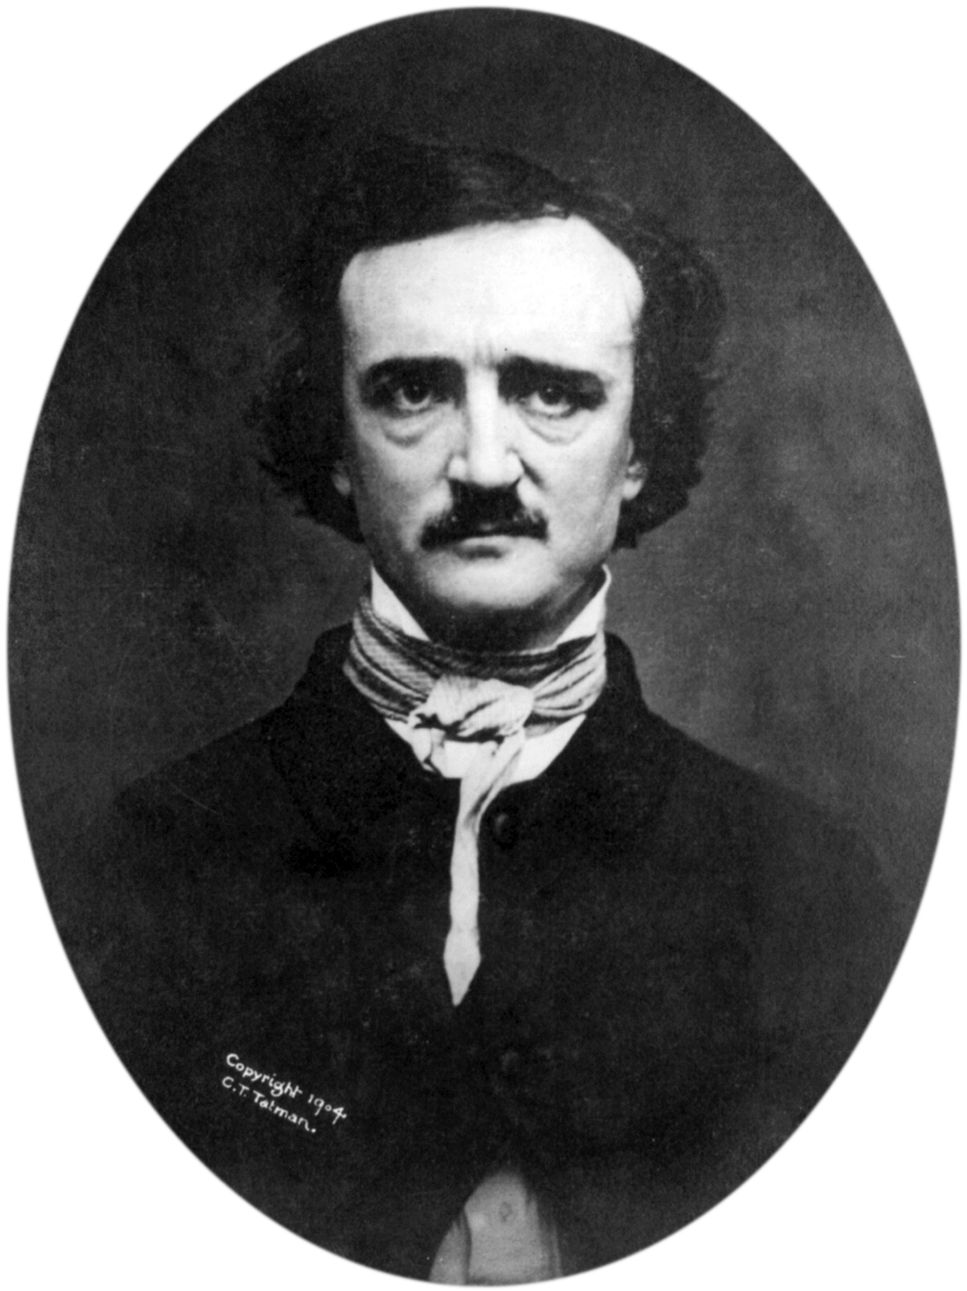
Gothic Literature (19th-20th centuries)
Marked by horror, melodrama, and a call back to the medieval.
A combination of fiction, horror, and Romanticism.
Well-known authors of gothic literature include Edgar Allen Poe (“The Cask of Amontillado”) and Bram Stoker (“Dracula”).
Notes:
Gothic literature is sometimes considered a part of Romantic literature, sometimes considered a separate movement. In either case, they do tend to share similarities in form.

Slide 6
Style
Epistolary novel
Written as a series of letters from Captain Robert Walton to his sister, Margaret Seville
Often used to add greater realism, as it mimics the workings of reality
Offers multiple points of view without an omniscient narrator

Slide 7
Style (continued)
Walton as narrator (Writing the letters about Victor’s story
Victor as narrator (Telling his story and the story of the monster)
Monster as narrator, telling its story to Victor
Notes:
Frankenstein’s narrative structure can be a bit confusing at first. Overall, it is a story seen through the letters Captain Walton is writing to his sister. However, those letters also contain the story which Victor is narrating with regards to his creation of the monster and the aftermath of that event. Additionally, the monster at one point is telling Victor what has happened to him after he was abandoned, essentially making Frankenstein a story within a story within a story.

Slide 8
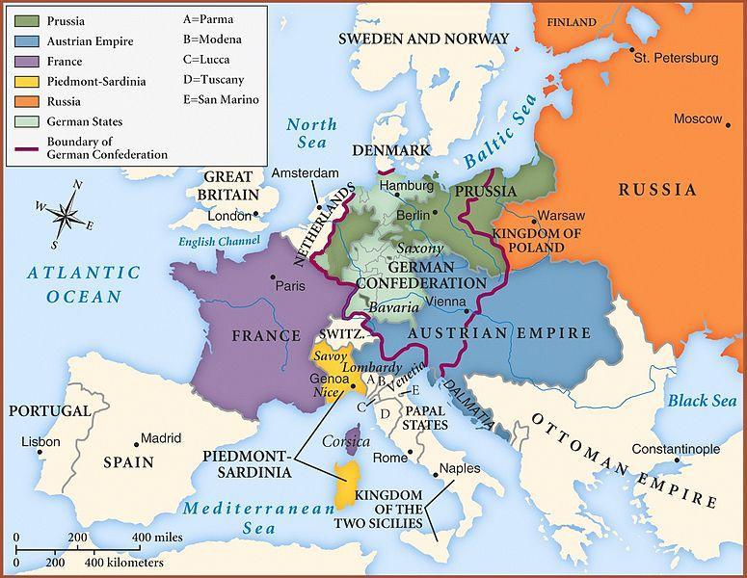
Setting
Overall: North Pole
Frankenstein’s tale takes place primarily in Germany, Geneva (Switzerland), Scotland, and Ireland.
Notes:
Map of the world at 1818. Due to some awkward political fragmentation, the German Confederation was a series of 39 German states loosely bound together, though as noted on the map they also entered the territories of Prussia and the Austrian Empire. Things would remain like this until about 1848, when Germany became its own independent country.
Note the locations of Beowulf (Denmark) and Othello (Venice/Cyprus)

Slide 9
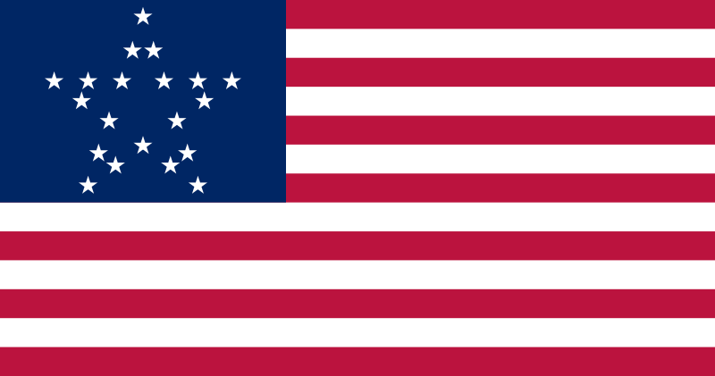
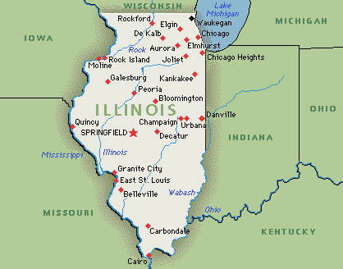
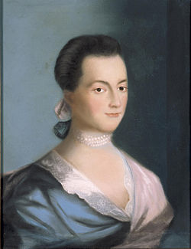
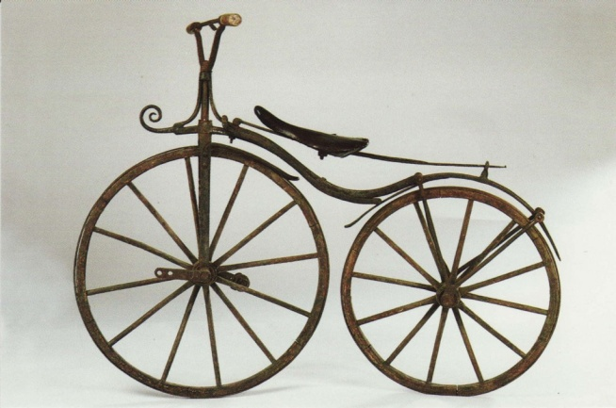
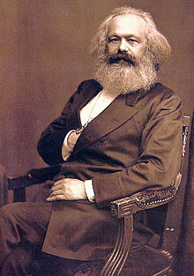
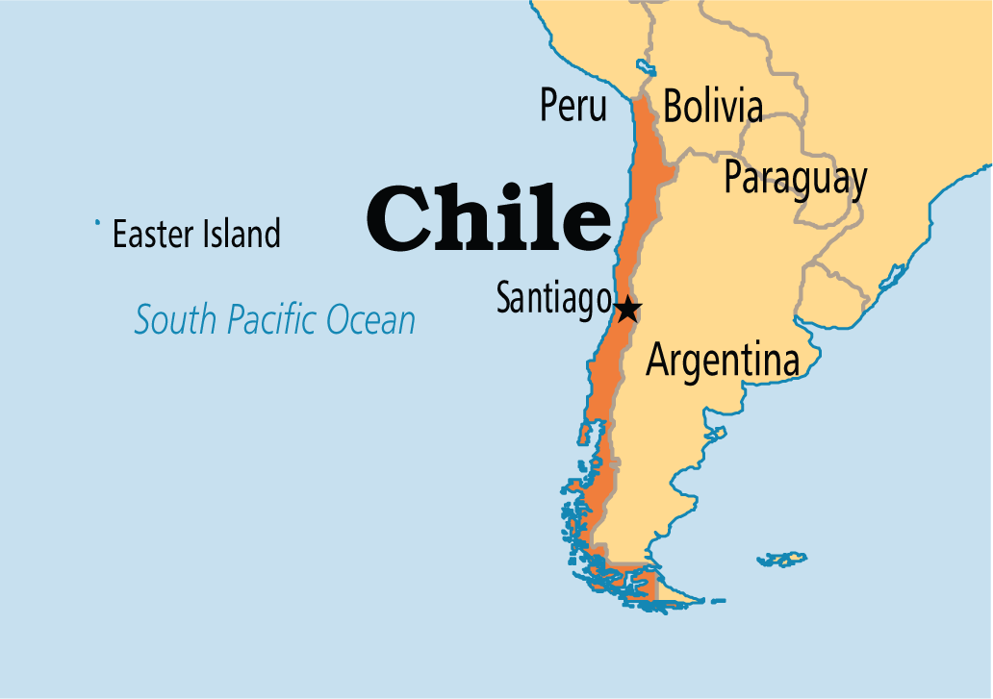
Also in 1818…
Abigail Adams
Karl Marx
Notes:
Though there were 3 versions of the American Flag at this point, this is probably the most popular
Illinois was admitted as the 21st state of the US
The bicycle was just being invented in Europe (by multiple companies)
Karl Marx, the founder of Marxism, was born in 1818
Chile gained its independence from Spain
Abigail Adams, a lead figure in the feminist movement, died in 1818

Slide 10
End
Notes:
This is a sort of buffer between the main PPT and some extra things that were either too high-level or just not interesting enough for the students when it was first presented.

Slide 11
The Epigraph
“Did I request thee, Maker, from my clay
To mould me Man? Did I solicit thee
From darkness to promote me?”
John Milton, Paradise Lost (X.743-5)

Slide 12
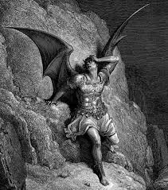
Paradise Lost
Epic poem written by John Milton (and his daughters) in 1667
Follows the Fall of Lucifer, the Creation of Adam and Eve, and the eventual Fall of Mankind
Much of Frankenstein was influenced by “Paradise Lost;” names (Victor) and characters (the monster) were modeled after characters within the epic poem.
Main themes used from it in Frankenstein: dedication of parents to their children, creation of life, and abandonment.

