Slide 1
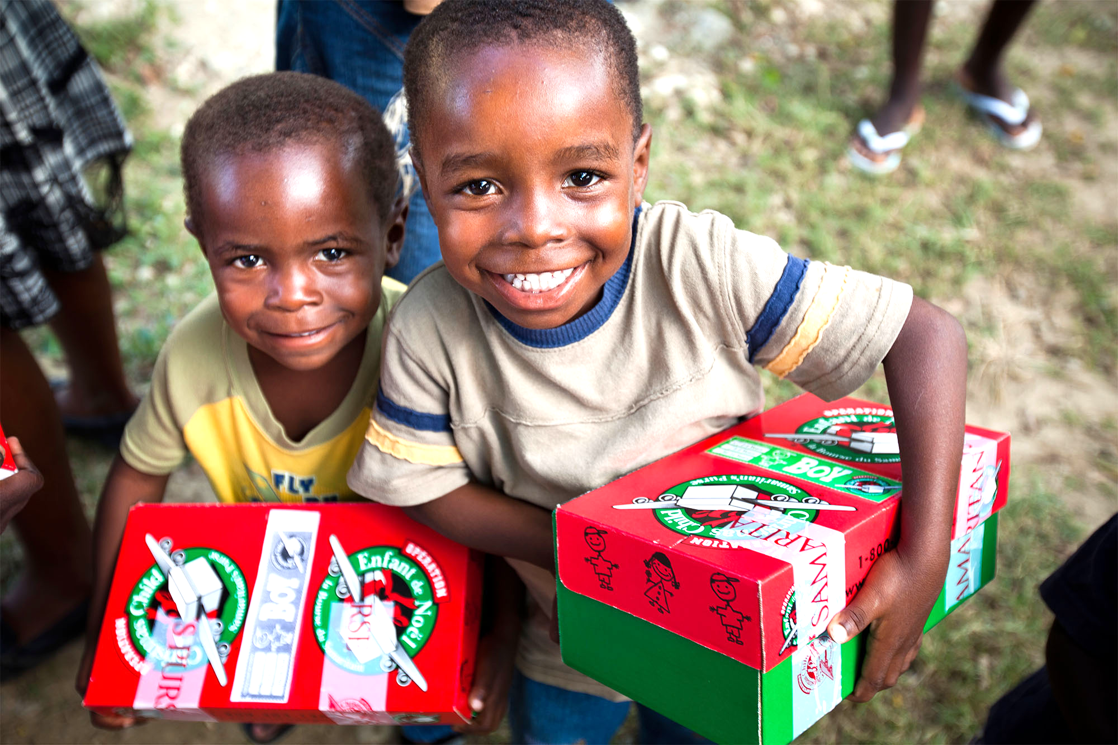
Operation Southwest
Gives
Operation Santa Claus• 2015

Slide 2
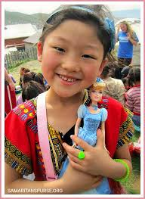
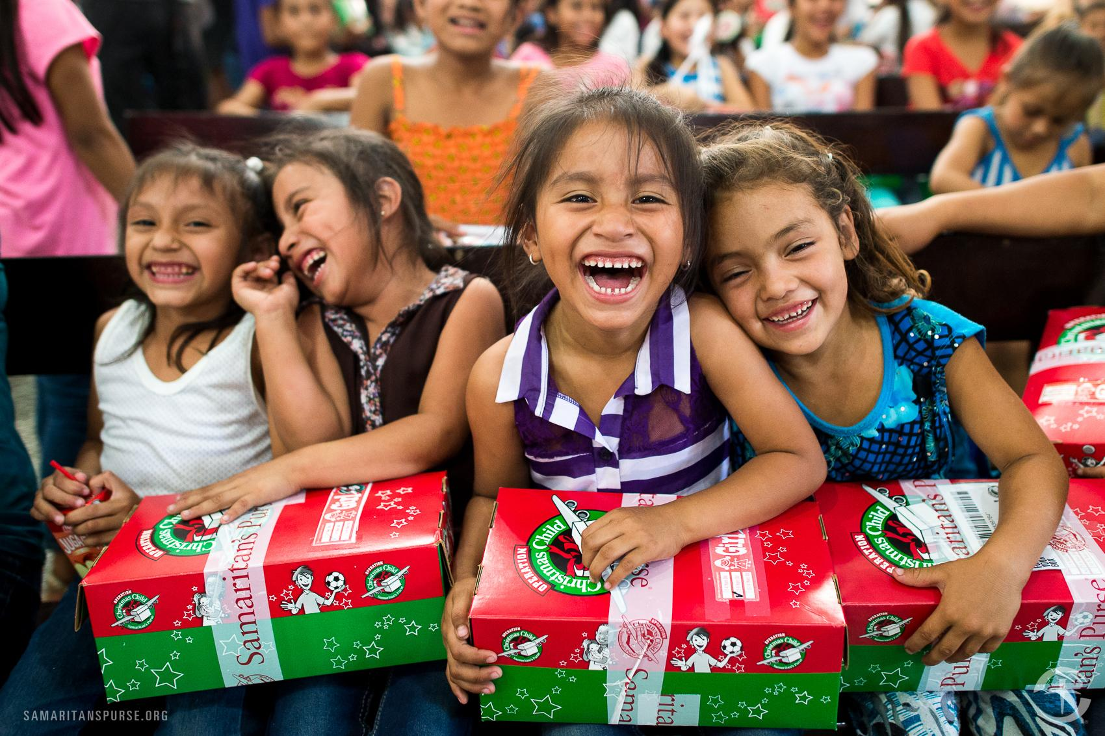
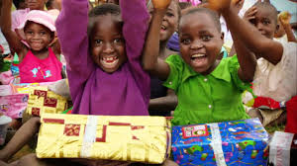
We have discussed the importance of opening our hearts & minds to the needs of others. Let us not be blind fish. A simple gift can have a profound impact.

Slide 3
2.2 Billion Children in the World
1 billion in poverty 1 small act of kindness
Immeasurable ripple effect

Slide 4
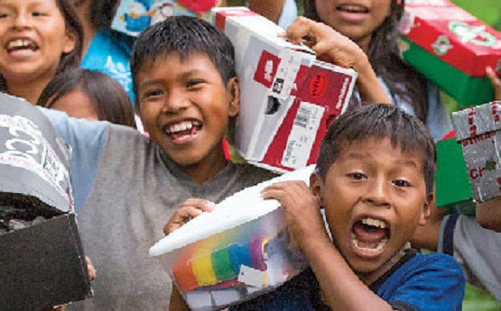
What to Pack?
Boys:
Toy cars, trains, trucks
Yo-Yo or slinky
Deflated ball with pump
Action Hero Figure
Musical Instrument
Stuffed Animal
Anything that lights up (include batteries if needed)
small books

Slide 5
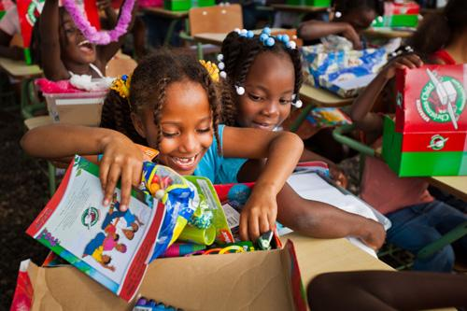
What to Pack?
Girls
Dolls of any kind
Dress up jewelry
Jump ropes
Stuffed animals
Musical instrument
Clothing or accessories
Small books
Stickers/coloring books
Hair accessories

Slide 6
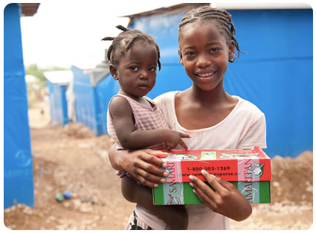
Meeting Needs
School supplies
Toiletries
Combs
Wash Clothes
Small items of clothing
Gloves
Hats
Socks
Sunglasses

Slide 7
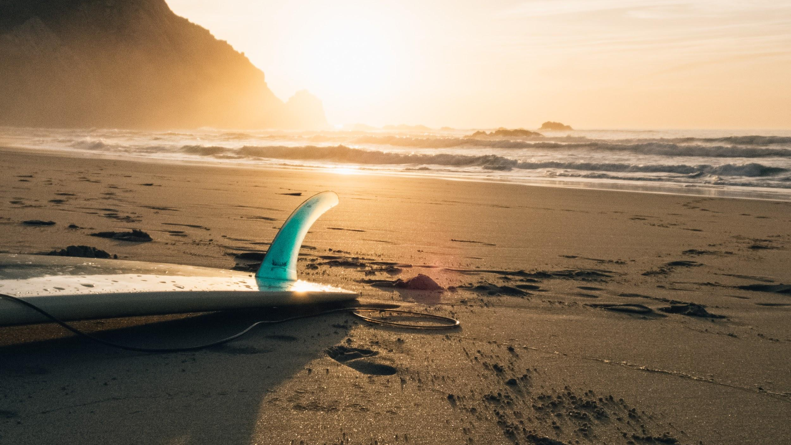
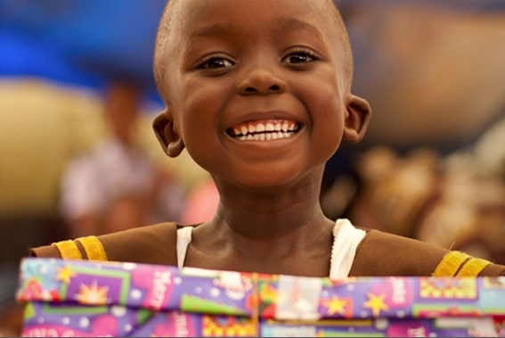
“It's not how much we give but how much love we put into giving.” -Mother Teresa

Slide 8
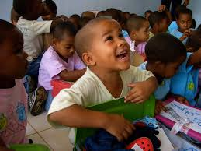
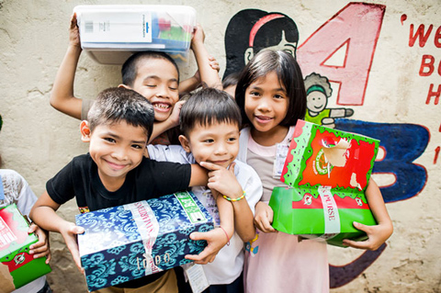
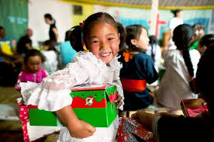

Slide 9
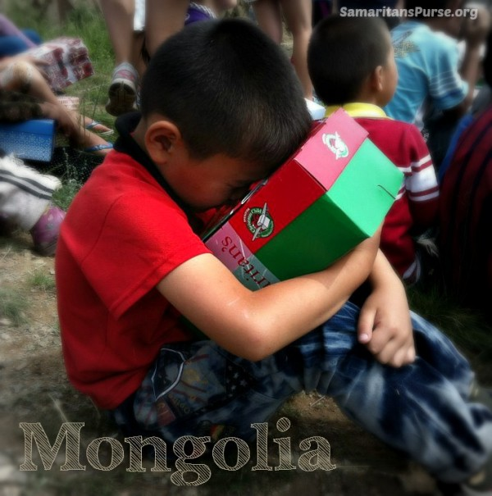
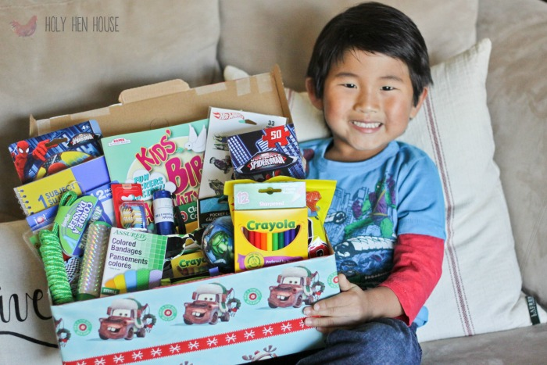
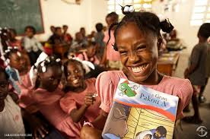
“We make a living by what we get. We make a life by what we give.” -Winston S. Churchill
“For it is in giving that we receive.” -Francis Assisi
“No one is useless in this world who lightens the burdens of another.” -Charles Dickens

Slide 10
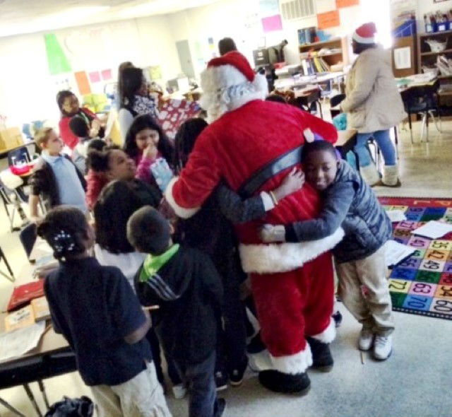
Hidden Valley Elementary
Charlotte, NC

Slide 11
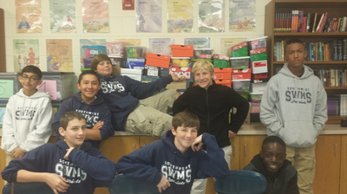
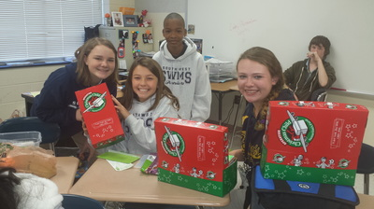
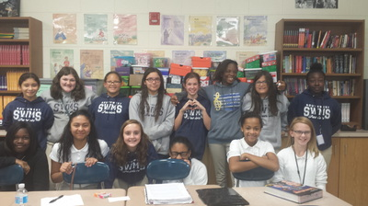
Monday
November 23rd
Snacks welcome
as we celebrate the joy
of giving

