Slide 1
Persuasive Techniques
Propaganda and Advertisements

Slide 2
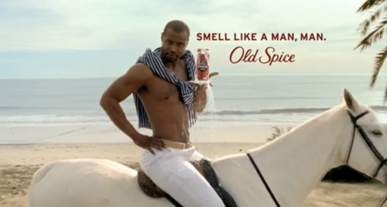
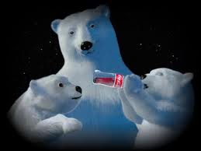
Emotional Appeal
Fear (Anti-Tobacco PSA)
Humor
Sympathy (ASPCA)
Warm Fuzzies

Slide 3
Loaded Language
Words with strong positive or strong negative connotations

Slide 4
Bandwagon Because everyone else is…

Slide 5
Association Links a product to something desirable

Slide 6
Experts

Slide 7
Testimonial

Slide 8
Celebrity Endorsements

Slide 9
Glittering Generalities Vague but attractive words that appeal to one’s values, emotions and ideals

Slide 10
Repetition

Slide 11
Transfer carrying over good feelings about one object to the product

Slide 12
Fundraiser Project
The next few slides will help us discuss the goal and purpose of the group project you will be doing this week.
With your group members you will:
Choose a non-profit organization
Organize a mock fundraiser activity
Create an advertisement (using at least 3 of the persuasive techniques we discussed in slides 2-11). This can be a commercial and/or poster/billboard.
Present your fundraiser proposal to the class.

Slide 13
Propaganda
(noun) information, especially of a biased or misleading nature, used to promote or publicize a particular political cause or point of view

Slide 14
Solicit
(verb) ask for or try to obtain (something) from someone

Slide 15
Non-Profit Organizations
Samaritan’s Feet
ASPCA
St. Jude’s Children’s Research Hospital
Wounded Warrior Project
Habitat for Humanity
Ronald McDonald House Charities
Save the Children

Slide 16
https://www.youtube.com/watch?v=azttKmT0rVc

