Slide 1
The Witch of Blackbird Pond
Elizabeth George Speare

Slide 2
Early Life
Elizabeth George Speare was born in Melrose, Massachusetts.
Speare said that Melrose was, "an ideal place in which to have grown up, close to fields and woods where we hiked and picnicked, and near to Boston where we frequently had family treats of theaters and concerts." (Biblio.com)
She had a very supportive, loving family, including one brother.
Though she began writing at age 8, and received a higher education in English, she only became serious about her writing once her children became older.
Speare lived a long life and died of an aortic aneurysm on November 15, 1994 at age 84.

Slide 3
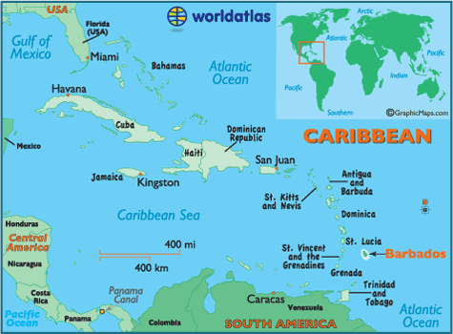
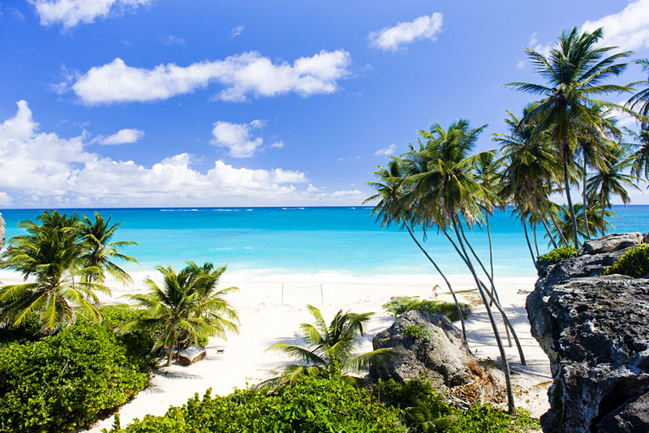
Settings
Barbados is in the eastern Caribbean, is an independent island nation within the British Commonwealth. At the time the novel was set, English settlers had colonized Barbados, bringing slaves from Africa to work their sugar plantations.

Slide 4
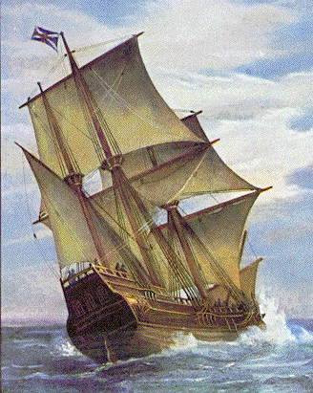
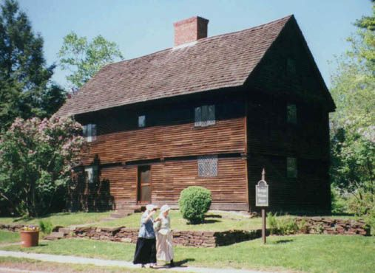
Settings
1687-1688
Puritan settlement of Wethersfield in the Connecticut colony

Slide 5
Setting
Monarch ruled England
Royalists
England ruled over the American colonies
Sir Edmund Andros (1637-1714) was appointed, by King James II, as governor of New England.The colonists did not like his rule as he limited their political, religious, and property rights. The colonists revolted after King James II was overthrown.

Slide 6
Puritans
People part of religious movement in the late 16th and 17th centuries who sought to reform the Church of England
Puritans came to America (many to New England) seeking religious freedom after persecution following the separation from the Church of England into their own congregations.
Puritans were deeply religious and were not tolerant of differing viewpoints.
Puritans saw the theatre (acting) as immoral.

Slide 7
Quakers
AKA “Society of Friends”
Christian group from in the mid-17th century in England, but quickly spread to other countries, like the American colonies.
Quakers were often persecuted for their free spirited worship, which stemmed from a belief in a personal, direct relationship with God.
They did not follow rituals such as baptism and communion, and were not led by ordained ministers.

Slide 8
Witchcraft
From the Middle Ages through the early 18th century there were many people (mostly women) in Europe who were tried for witchcraft and burned at the stake.
One method of proving a person to be a witch was the “water trial” where a person was put into a body of water and if she floated, that was proof of guilt, but if she sank she was not considered to be a witch.
The English settlers in the American colonies continued this persecution for years.
The most well known instance was in 1692 in Salem, Massachusetts, which led to widespread hysteria and panic, ending with dozens of hangings.

Slide 9
Characters
Katherine (Kit) Tyler- raised in Barbados (wealthy) until death of parents, forcing her move to New England to stay with distant relatives.
Nathaniel (Nat) Eaton- first mate on the ship (Dolphin). Falls in love with Kit.
The Wood Family (Matthew, Rachel, Judith, and Mercy)- Kit’s Puritan aunt, uncle and cousins.
Reverend Gershom Bulkeley- Wethersfield’s minister and doctor (Royalist).
Hannah Tupper- Quaker widow living in a small house on Blackbird Pond (suspected of witchcraft).

Slide 10
Other Characters
John Holbroook- young Puritan clergyman who falls in love with Mercy Wood.
The Cruffs- Mean family of Prudence Cruff, who is abused.
William Ashby- son of wealthiest family in Wethersfield who courts Kit initially before falling in love with Judith.

Slide 11
Themes
Human struggle for freedom...

